Slide 1





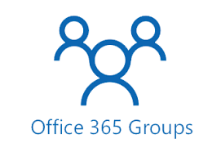





O365
Cheat
Sheet
O365 Groups
An O365 Group has Owners and Members. In private groups Owners allow Members to join
An O365 Group has a collection of resources like a shared mailbox and a document library to which both Members and Owners have access
O365 Group Owners are Site Collection Admins in SharePoint. O365 Group Members are Site Members in SharePoint
An O365 Group can optionally have a (1) corresponding O365 Team
O365 Teams
An O365 Team always has one (1) corresponding O365 Group
When you create a new O365 Team an O365 Group is automatically created
You can create an O365 Team for an existing O365 Group
An O365 Team has the same Owners and Members as an O365 Group and vice versa,
An O365 Team re-uses the resources of an O365 Group
Private Channels
An O365 Team can have multiple Private Channels
A Private Channel has its own Owners and Members
A Private Channel has its own corresponding SharePoint site.
Private Channel Owners are Site Collection Admins/Owners in SharePoint. Private Channel Members are Site Members in SharePoint
O365 Team
Chat/Voice/Channels
Private Channel
Many
1
1
1
1
1
Site Collection Admins (Admin)
Site Owners (Full)
Site Members (Edit)
Site Visitors (Read)
Members
Owners
Document Management
1
1
1
1
Site Collection Admins (Admin)
Site Owners (Full)
Site Members (Edit)
Site Visitors (Read)
Document Management
Shared e-Mail inbox and Calendar
Note-taking
Task Management

